Slide 1
Project Title: Pressure gauge calibration by IA workshop team
Business Case/objectives:
During the last 6 monthly pressure gauges calibration for Okoloma gas plant, there were a total number of 56 defective gauges that needed replacement. This initiative is to utilize the IA Instrument resources to execute this 3rd party activity and also replace some of the defective gauges. Cost savings of $3,573.8 to be derived from workshop execution of activity for 2 runs in a year (May and November 2018), benchmarking from previous execution in WO: 22506295 and agreement no: 4610042575.
Also workshop to provide 23pcs gauges out of 56pcs defective gauges thereby achieving a cost savings of $22,925.93 (revised number of gauges post activity, from $33,206.42 to $10,280.49 See reduction in cost from SAP WO: 22662533)
Total cost savings: $26,499.73
Potential Benefits & Measurement:
circa $26,499.73
Project Scope/Actions :
Obtain required gauges from the workshop
Procure outstanding gauges requiring replacement
Execute 6 monthly pressure gauge inspection - Workshop
Critical Success Factors:
Fast tracking of PO for gauge delivery
Mobilization of workshop team to site
High-level Timeline:
L0-L1: November 1 2018
L2: November 10 2018
L3: November 15 2018
L4: November 25 2018
L5: December 2018
Initiative End
Project Sponsor: Onyeka Ikechukwu Implementation Lead: Ogbodu Rume
Project Team:
Attoe Patrick
Obioha Obinna

Slide 2
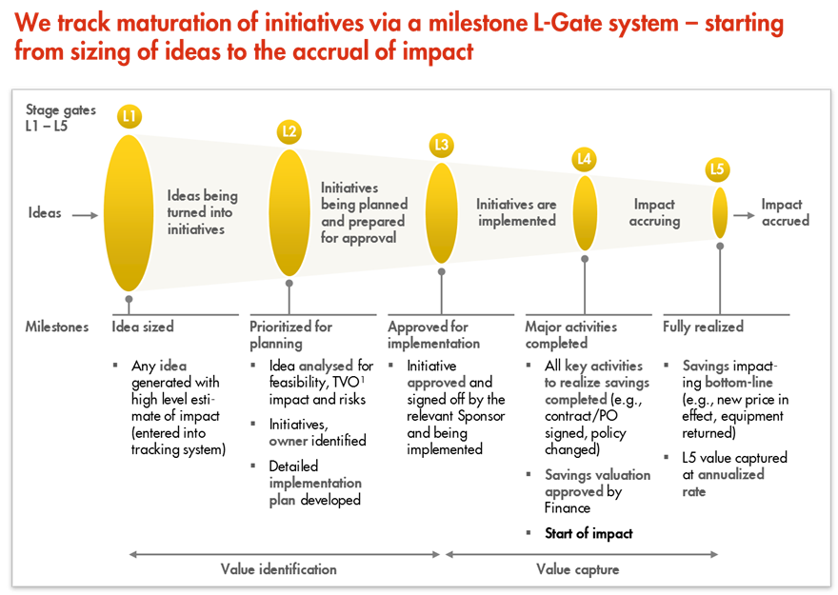
L1 – L5 Gates

